Slide 1

Tax Assessment using ML model
1
Rakshitha Murali Krishna

Slide 2



Objective
2
1)The primary objective of this project is to develop a predictive model that accurately estimates the tax of a house based on various features such as its sale price, location (zipcode, longitude, latitude), lot size, year built, square footage, number of bedrooms and bathrooms, garage, fireplaces, and other relevant factors.
2) Once developed, the government can utilize this model to predict the tax band for newly built or existing houses based on their specific characteristics.

Slide 3

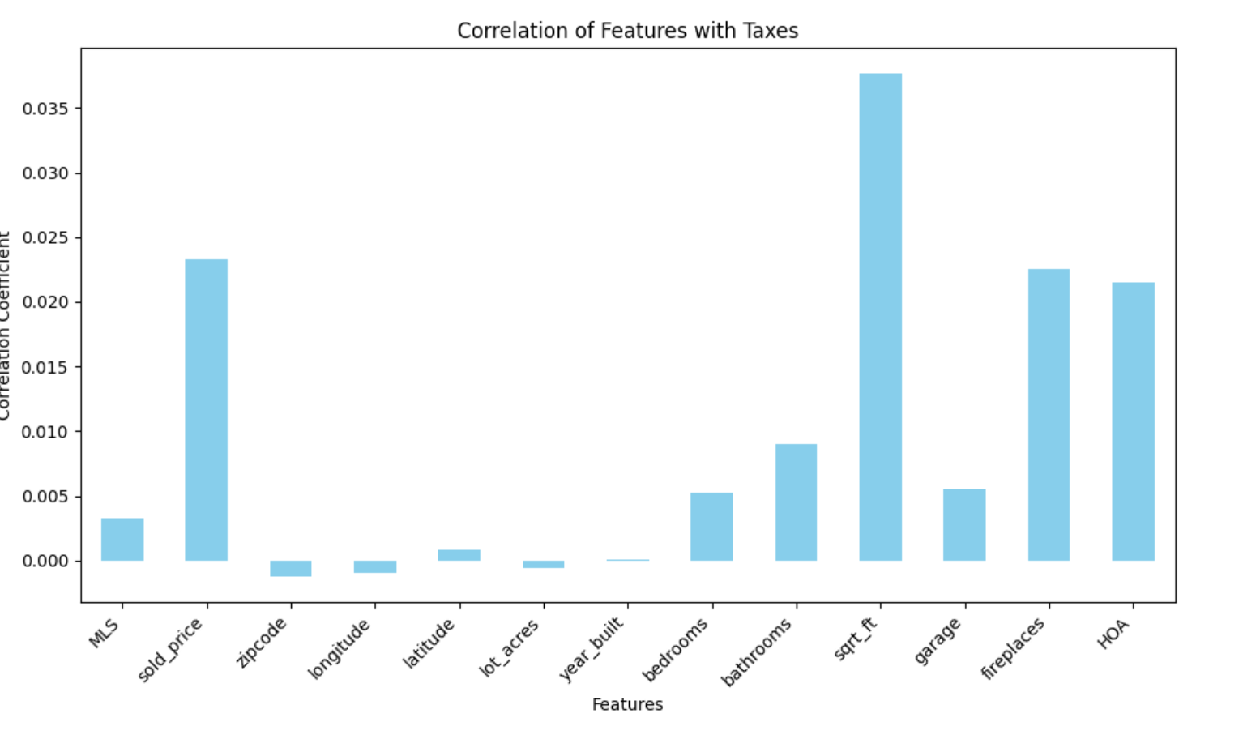
Step 1: Predicting the features that affect the tax price. In this graph, we can see that sqrt_ft, bedrooms, bathrooms, fireplaces and HOA are affecting tax prices. So, consider those as input variables.
3

Slide 4
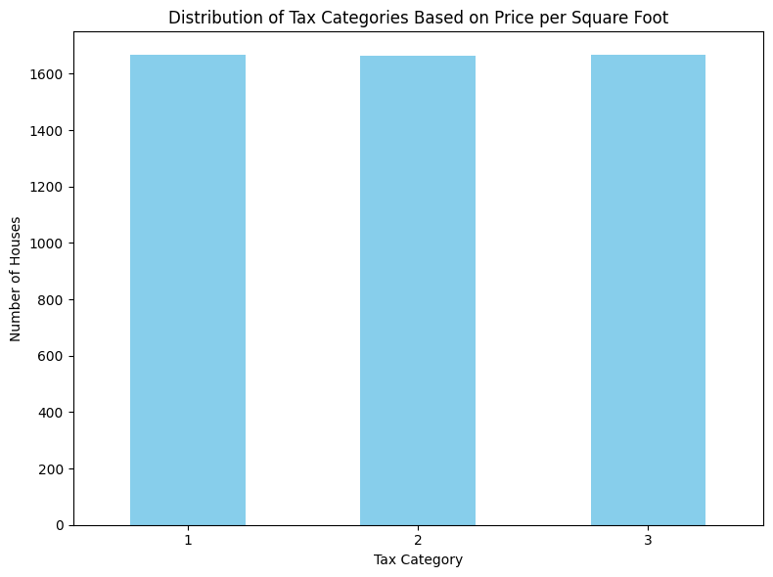
Step 2: Feature Engineering
3
Taxprice per square ft = Tax price/ Square feet
Categorize the Tax price based on Taxprice per square ft value.

Slide 5
Step 3: Selection of Model.
Input parameters:
Sqrt_ft
latitude
longitude
Output Parameter:
Tax_category
Model selected
K Nearest Neighbour is used to predict Tax band for newly built house.
4

Slide 6
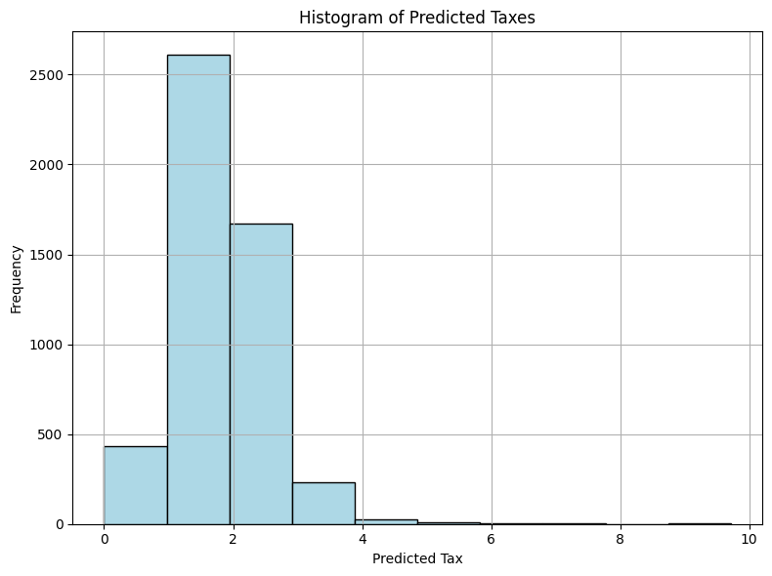
6
Concentration: Most predicted tax values fall between 1 and 3, indicating a high concentration in this range.
Peak Frequency: The highest frequency is observed within these bins, suggesting that the majority of predictions are clustered here.

Slide 7
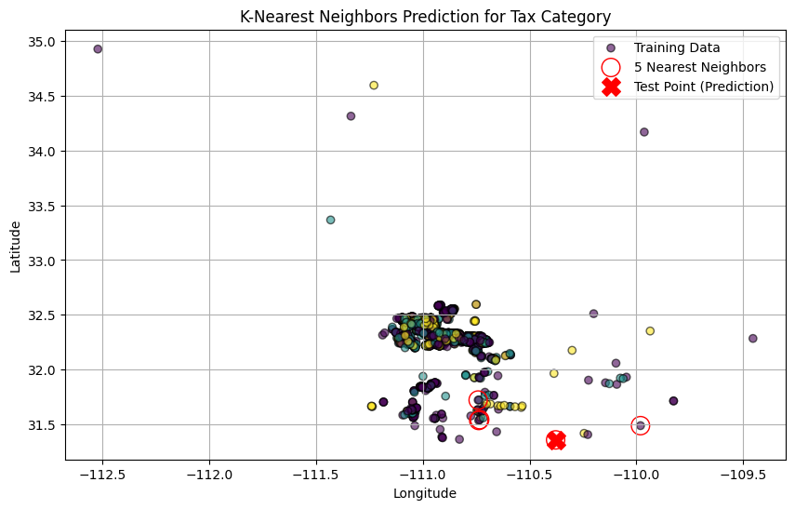
5
Result :
Latitude:
-110.3782 Longitude: 31.356362
Sqft:1173.0
Category=1

Slide 8
5
Result :
Taxes
Category 1:
0-5000
Category 2:
5000-10000
Category 3:
10000 and above

Slide 9

Summary
13
Findings:
The model is able to predict tax category for
newly built houses or existing houses.
2) Improvement in the model is necessary for
predicting actual tax amount
3) Government can use this model to predict tax
band for a newly built house.
The model provides reliable estimates of tax rates, aiding in effective tax planning for new developments.

Slide 10
Any Questions please?

Slide 11


Thank You
Rakshitha Murali Krishna
Rakshithakrishna1997@gmail.com

